Slide 1
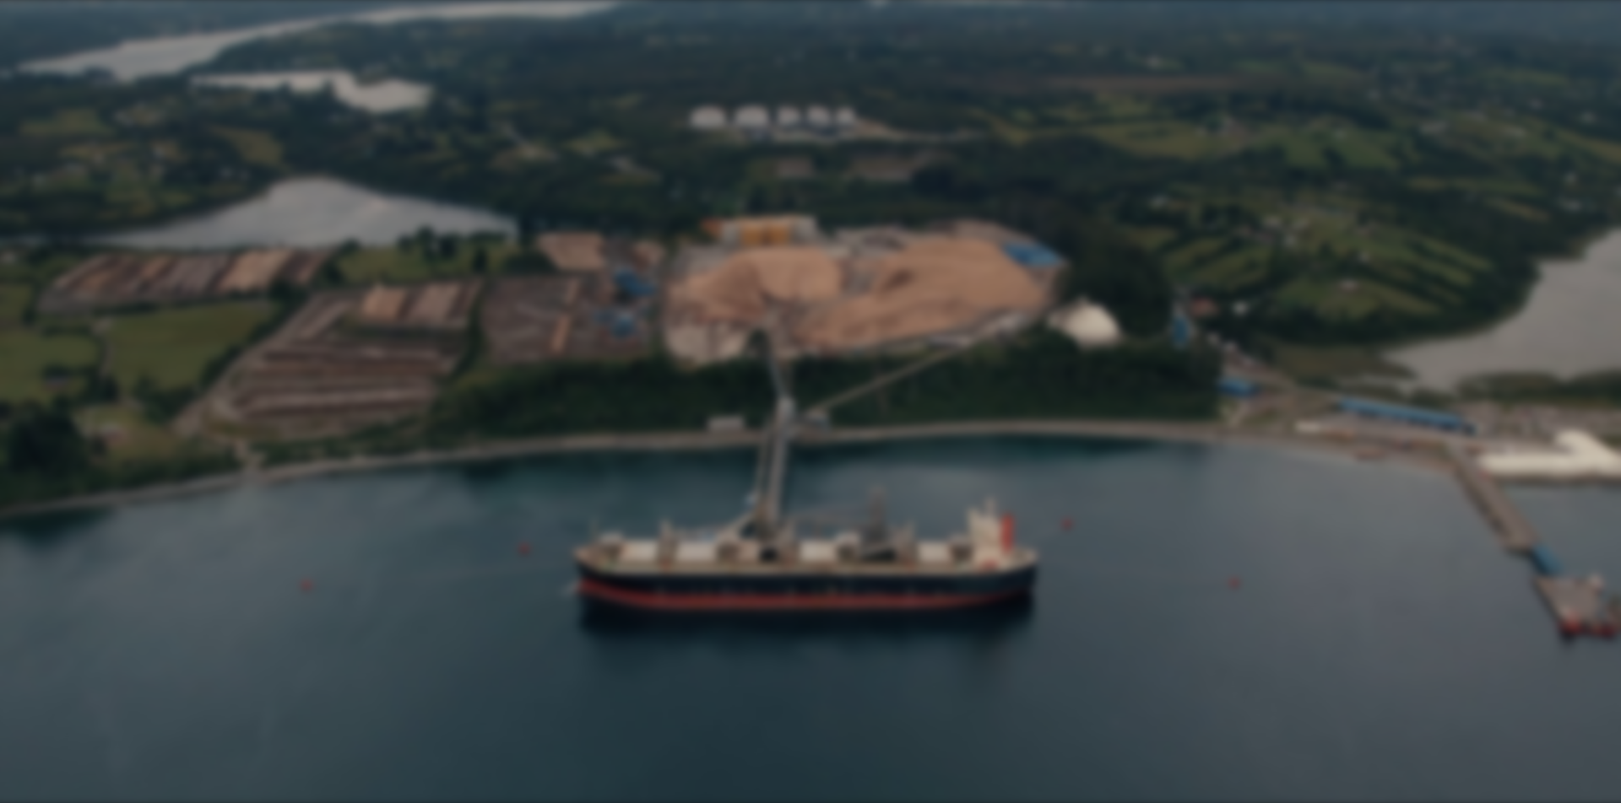

COMPANY OVERVIEW
December 2024

Slide 2

DISCLAIMER
ONE PAGER
GENERAL OVERVIEW
STRENGHTS
CORE BUSINESSES
FINANCIAL OVERVIEW
Anexos
DISCLAIMER
The information included in this document is given in summary form and does not purport to be complete. Information in this presentation, including forecast financial information, should not be considered as advice or a recommendation to investors or potential investors in relation to holding, purchasing or selling securities or other financial products or instruments and does not take into account your particular investment objectives, financial situation or needs. Before acting on any information you should consider the appropriateness of the information having regard to these matters, any relevant offer document and in particular, you should seek independent financial advice. All securities and financial product or instrument transactions involve risks, which include (among others) the risk of adverse or unanticipated market, financial or political developments and, in international transactions, currency risk.
This presentation may contain forward looking statements including statements regarding our intent, belief or current expectations with respect to GEN’s businesses and operations, market conditions, results of operation and financial condition, capital adequacy, specific provisions and risk management practices. Readers are cautioned not to place undue reliance on these forward-looking statements. GEN does not undertake any obligation to publicly release the result of any revisions to these forward-looking statements to reflect events or circumstances after the date hereof to reflect the occurrence of unanticipated events. While due care has been used in the preparation of forecast information, actual results may vary in a materially positive or negative manner. Forecasts and hypothetical examples are subject to uncertainty and contingencies outside GEN’s control. Past performance is not a reliable indication of future performance.
This document was prepared by GEN with the sole purpose of providing general information about the company and its subsidiaries.
COMPANY OVERVIEW | DECEMBER 2024

Slide 3


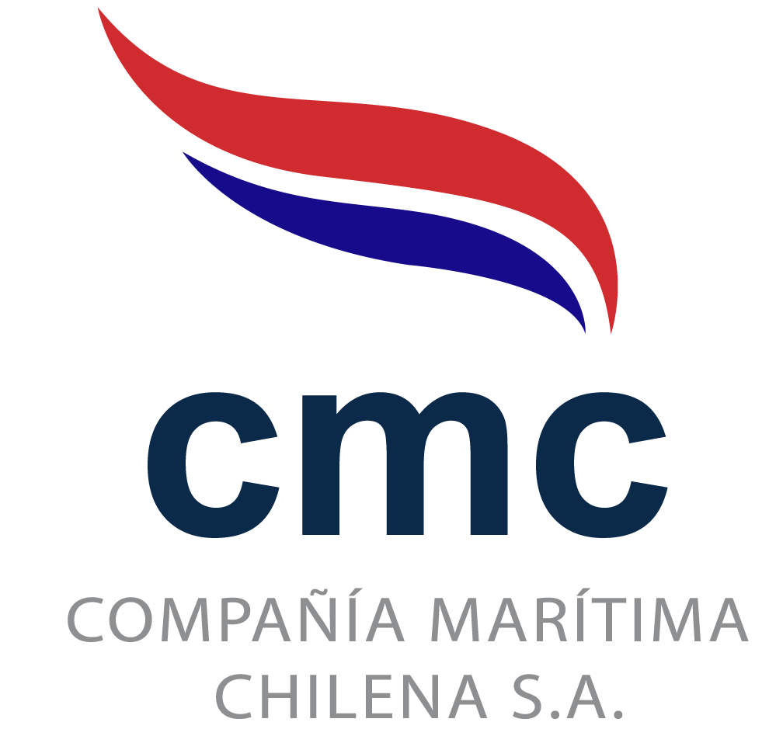




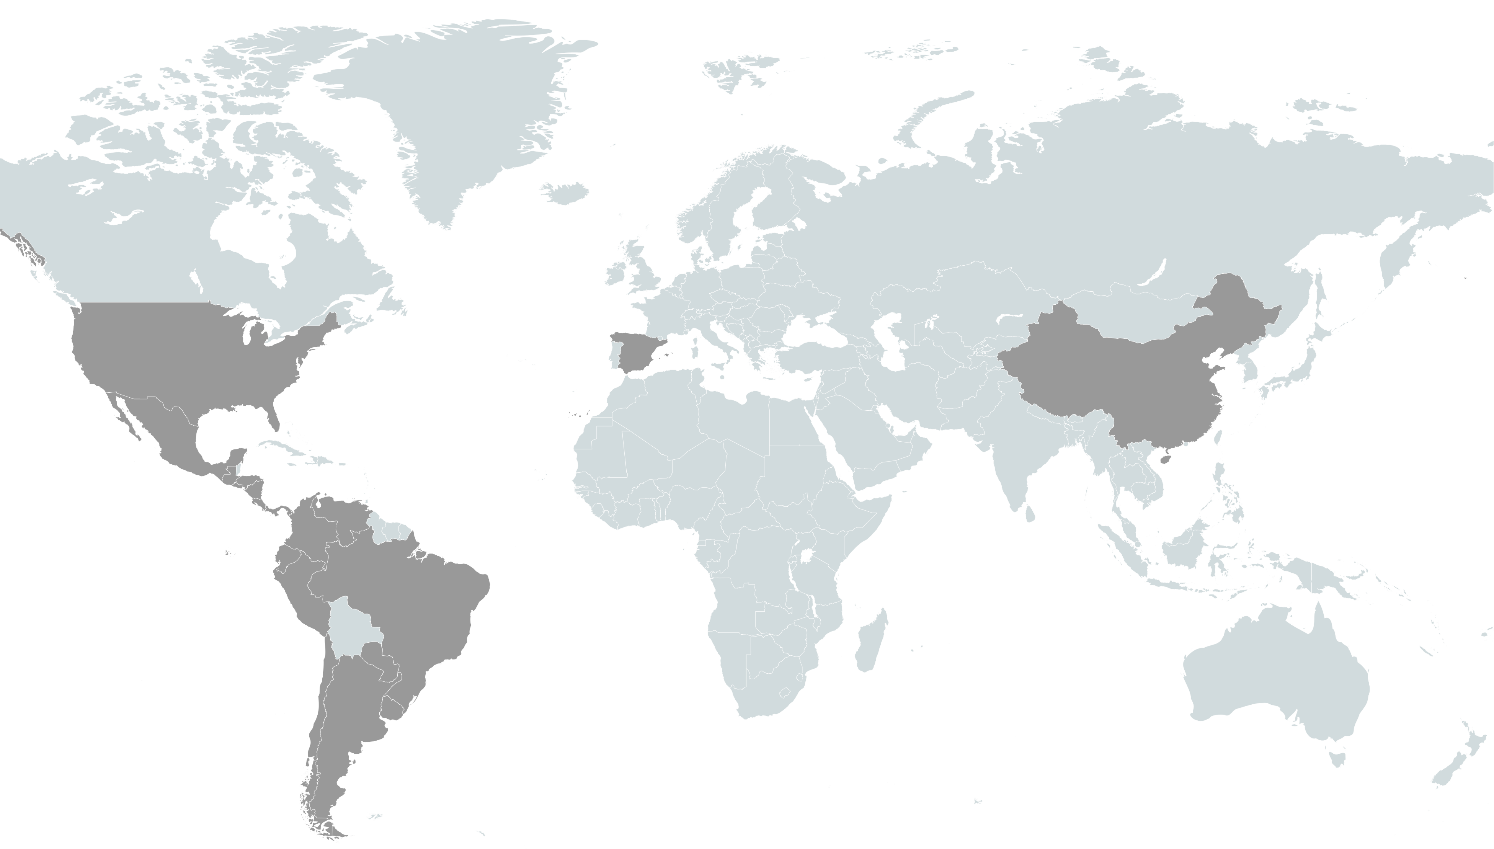




















DISCLAIMER
ONE PAGER
GENERAL OVERVIEW
STRENGHTS
CORE BUSINESSES
FINANCIAL OVERVIEW
ONE PAGER
BUSINESS LINES
A group of companies that moves the world
SHIP OWNING & CABOTAGE
Owners of Container Vessels , Tankers Vessels, Tugboats, Wellboats, Barges, Ferrys
+ 110 units
GEN has 91 years of history, being one of the main logistics operators in the activities of maritime, land and air cargo.
+19.249.101
Tones of cargo
+15.400.000 AGUNSA + 3.849.101 PCF
PORTS
Port operations through different concessions
Agency,
Port Agency, Protecting Agency, Bunkering and others
+3.700
Ships Attended
Confirmar Información Cristián: +3.700
Ships Attended
AGENCY
LOGISTICS
Warehousing & Logistic services
+435.000 m²
USD Revenue
USD EBITDA
Experience
Presence
Staff
+ 970 Million
Year 2024
+ 172 Million
Year 2024
+90 years
+21 Countries
+7.000
Passenger services, logistic services to the aircrafts and others.
+2.680.000
Passangers
+2.680.000
Passangers embarcados a dic 2024
AIRPORTS
3
COMPANY OVERVIEW | DECEMBER 2024

Slide 4





DISCLAIMER
ONE PAGER
GENERAL OVERVIEW
STRENGHTS
CORE BUSINESSES
FINANCIAL OVERVIEW
GENERAL OVERVIEW
CONCENTRATED OWNERSHIP⁽¹⁾
ORGANIZATIONAL STRUCTURE
99,58%
91,9%
99,35%
Actualizado a dic 2024 (Directorios→ Informe financiero Carátula)
50,0%
99%
75%
35%
75%
Source: Company information
Dic 2024
COMPANY OVERVIEW | DECEMBER 2024

Slide 5


DISCLAIMER
ONE PAGER
GENERAL OVERVIEW
STRENGHTS
CORE BUSINESSES
FINANCIAL OVERVIEW
REVENUE & EBITDA DISTRIBUTION
NUMBERS AT A GLANCE (MM USD)
Logistics Ship Owners Ports Airports Agency Services Others
REVENUES
2020: 585
2021: 757
2022: 962
2023: 902
2024: 970
PROFIT (LOSS)
2020: 18
2021: 76
2022: 67
2023: 43
2024: 54
Revenues 2023
USD 902 mm
Revenues 2024
USD 970 mm
TOTAL ASSETS
2024: 1.496
TOTAL EQUITY
2024: 506
EBITDA
2020: 126
2021: 154
2022: 174
2023: 154
2024: 172
EBITDA Margin
2020: 21,6%
2021: 20,3%
2022: 18,1%
2023: 17,1%
2024: 17,8%
EBITDA 2023
USD 154 mm
EBITDA 2024
USD 172 mm
A (Stable)
A (Stable)
COMPANY OVERVIEW | DECEMBER 2024
Notes:
Resumen Segmentos hoja|

Slide 6

DISCLAIMER
ONE PAGER
GENERAL OVERVIEW
HISTORY
CORE BUSINESSES
FINANCIAL OVERVIEW
HISTORY
2017: GEN increased its stake in:
Froward
From 66,0% → 91,9%
AGUNSA
From 68,8% → 81,1%
CMC
From 74,5% → 83,2%.
2017: GEN sold its stake in Iquique Terminal Internacional S.A.
2020 (Feb): Placement of Bonds Serie B for UF 2.000.000 - 10 years.
2020 (Aug): Placement of Bonds serie E for UF 1.500.000 – 8 years.
2021: AGUNSA wins tender to operate Terminal 2 of Puerto de Valparaiso for 4 years.
2021: AGUNSA became the main logistical operator in the mining industry in Chile due to its multiple contracts in the mining sector.
2022: CMC completed the purchase of Don Pancho II, which joined its fleet to offer bunkering services for COPEC S.A for 3 years.
2023 (Sep): AGUNSA acquired a 75% stake in ESBO Logistics in Spain.
1960: CCNI founded AGUNSA, subsidiary company until 1989.
1983: Euroandina de Inversiones S.A. was formed - today Grupo Empresas Navieras S.A.
1994: GEN was listed on the stock exchange.
1930
2010
2011
2011
2019
2021
2022
2023
2024
2011: GEN made a successful placement of Bonds (Series A) in the local capital market for UF 1.200.000 - 14 years.
2014: 4 container vessels with a capacity of 9,000 TEUs were acquired and began their operations for CCNI.
2015: Container business lines operated by CCNI were sold to German liner HAMBURG SÜD. The sale also included the name and brand.
2019: GEN sold Terminal Puerto Arica S.A. participation.
2019: Through a Public Offering, GEN increases its stake in:
AGUNSA
From 81,1% → 98,1%
CMC
From 83,2% → 99,1%
2022: AGUNSA acquired a 75% stake in Carver Maritime’s Manatee Terminal Florida, becoming official in February 2023.
2022 (Jul): AGUNSA enters a joint venture with Menzies Aviation PLC to offer ground handling services in Latin-American.
2024: AGUNSA acquired a 70% stake in A.R. Savage Company, a maritime agency, freight forwarder, and maritime advisory firm on the west coast of Florida.
AGUNSA acquired a 58% stake in Omni Transloading & Logistics and Omni Bulk Services, enhancing its transloading and logistics operations in the United States.
AGUNSA acquired 100% stake in Algeciras Strait of Gilbraltar Shipping SL and Sociedad Gibport Services Limited
CMC adquired 2 Tanker Vessels (50.000 m3)
1930: Shipping companies “Braun & Blanchard” and “Menéndez Behety” came together and founded CCNI. By 1932 CCNI was offering regular services from Chile to Argentina, Uruguay, Brazil and Chile.
COMPANY OVERVIEW | DECEMBER 2024

Slide 7







DISCLAIMER
ONE PAGER
GENERAL OVERVIEW
STRENGHTS
CORE BUSINESSES
FINANCIAL OVERVIEW
STRENGTHS
BUSINESS DIVERSIFICATION
CORPORATE GOVERNANCE
STRONG FINANCIAL POSITION
STABLE EBITDA
GEOGRAPHIC DIVERSIFICATION
With presence in over 20 countries
POSITIVE OUTLOOK FROM RATING AGENCIES
STABLE BUSINESS AND PROPER DIVERSIFICATION
7
COMPANY OVERVIEW | DECEMBER 2024

Slide 8







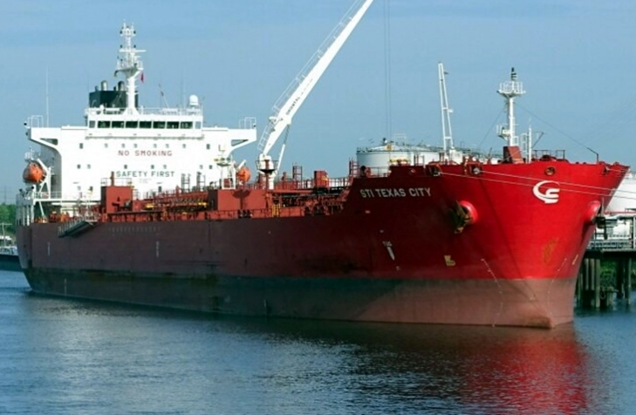
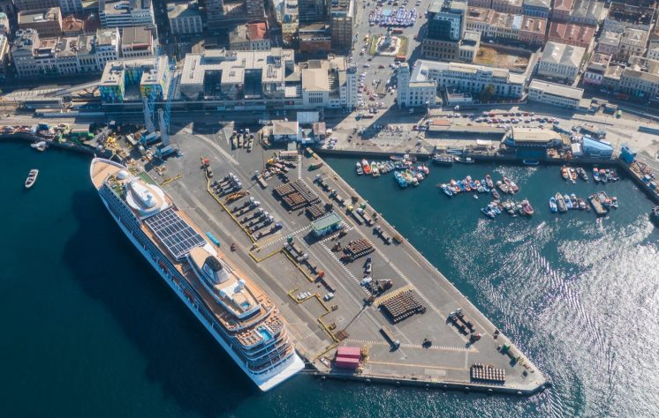
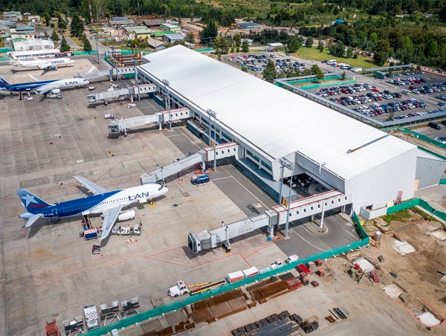
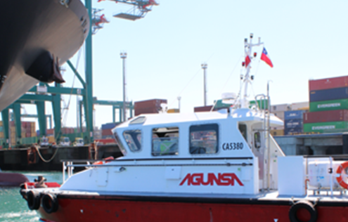
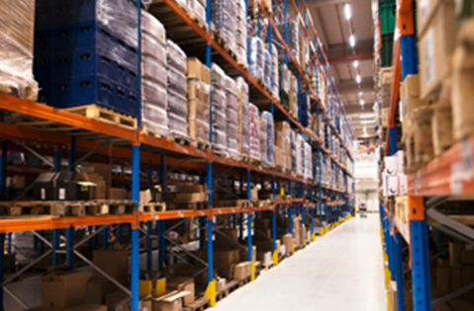
DISCLAIMER
ONE PAGER
GENERAL OVERVIEW
STRENGHTS
CORE BUSINESSES
FINANCIAL OVERVIEW
CORE BUSINESS
SHIPOWNING
PORTS
AIRPORTS
AGENCY SERVICES
LOGISTICS
COMPANY OVERVIEW | DECEMBER 2024

Slide 9

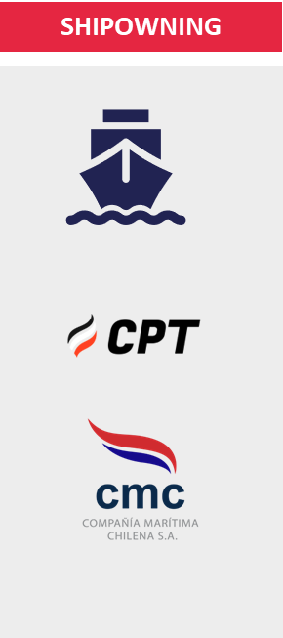
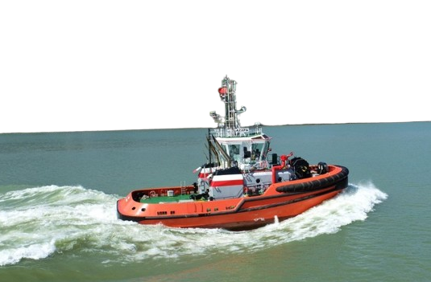
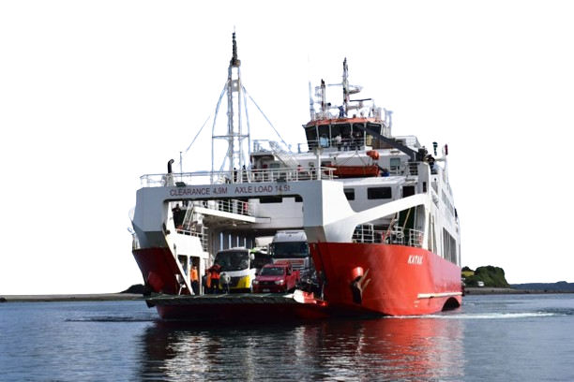
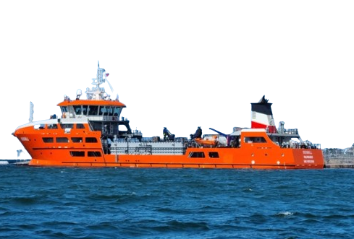
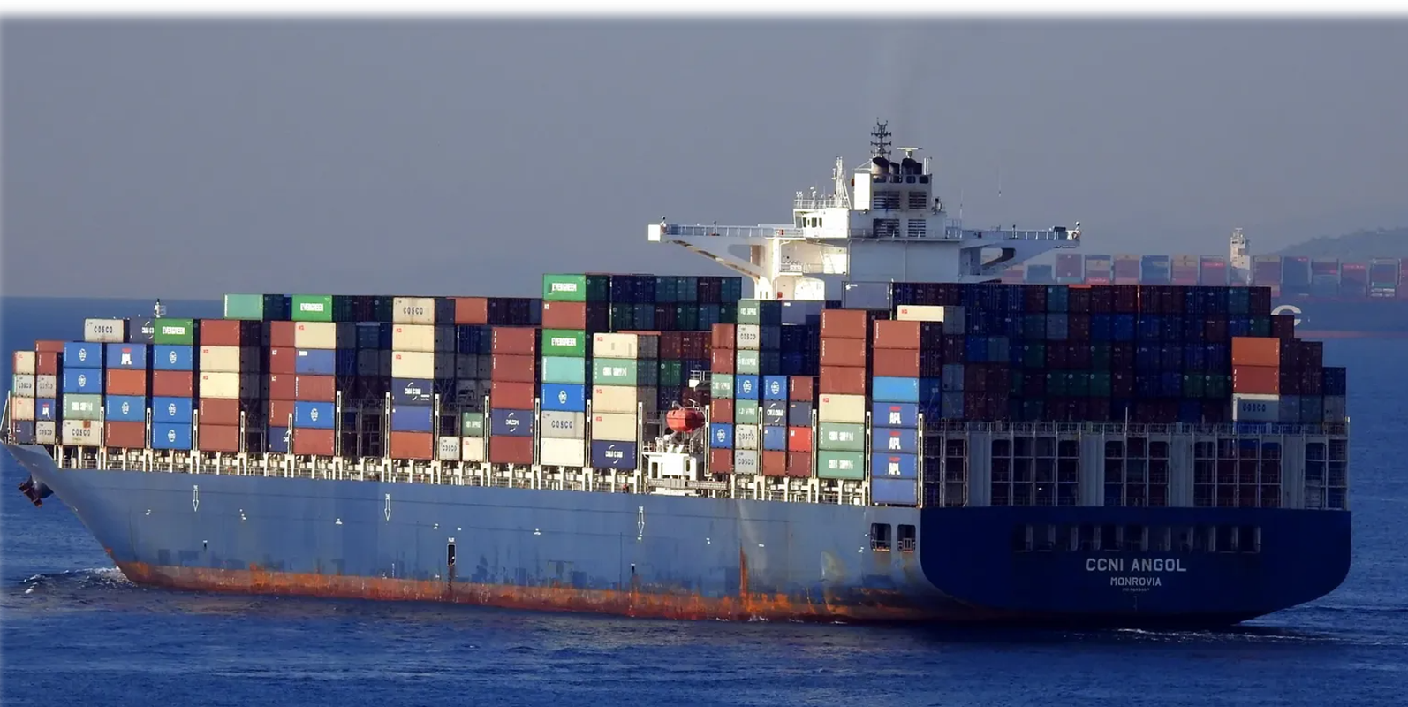
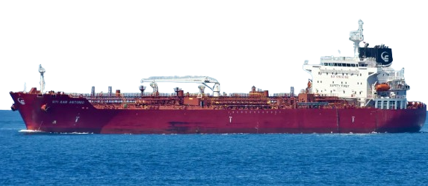
DISCLAIMER
ONE PAGER
GENERAL OVERVIEW
STRENGHTS
CORE BUSINESSES
FINANCIAL OVERVIEW
CONTAINER VESSELS
TANKER VESSELS
TUGBOATS
AUSTRAL NETWORK
WELLBOATS
  GEN & CMC: 4 x 9000 TEU containers vessels
  CMC: Co-owner of 2 x 3100 TEU container vessels (50% & 100% ownership)
    CMC:
    5 tanker vessels under time charter rate with ENAP
    2 x 51.700 m3 participates the international pool
    Bunkering Vessels: 2 vessels
    1 x 5000 m3 time charter with COPEC
    1 x 2500 m3 operated by AGUNSA
    CPT: 49 Tugboats
    Market Share: 27%.
    Through Transmarchilay (TMC) and its related companies:
    20 ferries
    20 barges
    27 motorboats.
    CPT is one of the main maritime and logistics service providers for the salmon industry.
    Total Fleet: 10 Wellboats
Angol
Antillanca
Revenue – EBITDA Margin (USDmm)⁽²⁾
Tanker Vessels⁽³⁾ by Operator
Source: Company Information
Number of tugboats
(2) Considers only companies that consolidate with GEN (CMC, Arauco y Angol)
(3) Chile Cabotage Vessels
COMPANY OVERVIEW | DECEMBER 2024

Slide 10
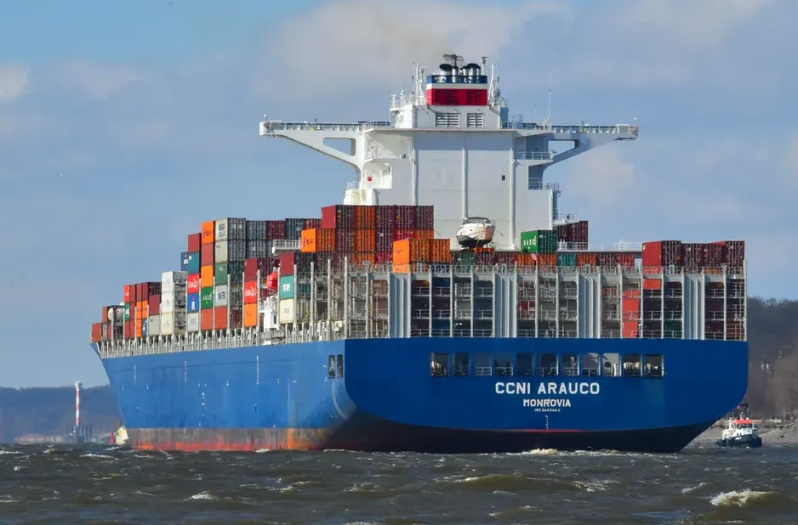
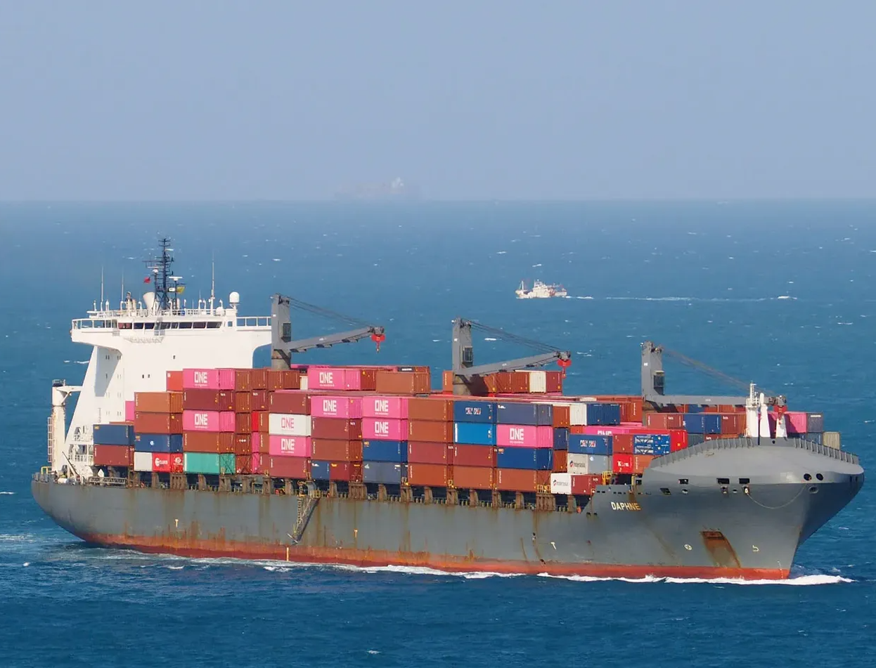
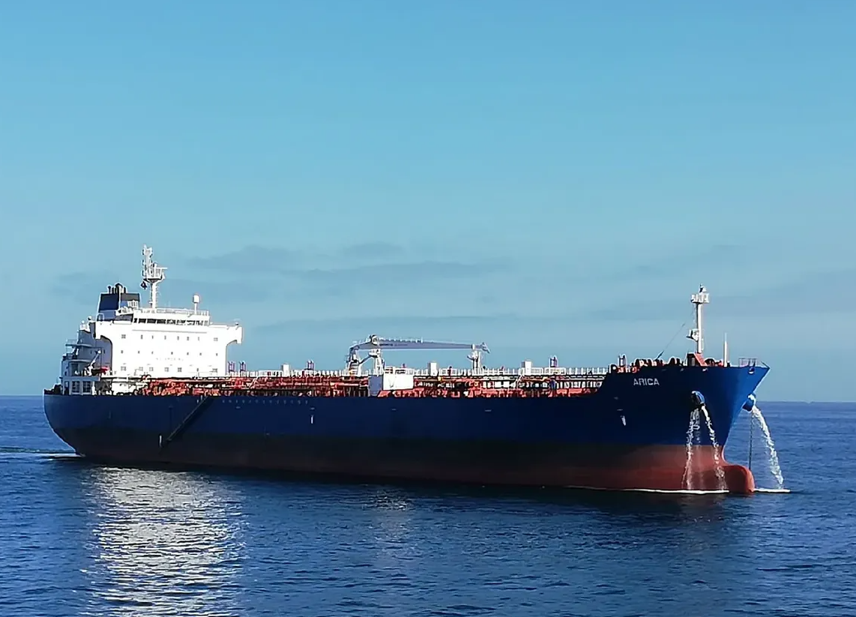
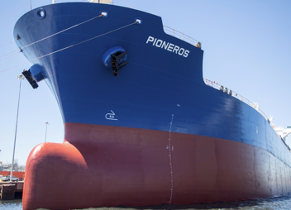
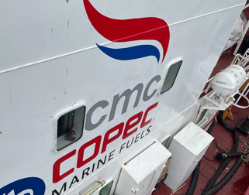











DISCLAIMER
ONE PAGER
GENERAL OVERVIEW
STRENGHTS
CORE BUSINESSES
FINANCIAL OVERVIEW
CMC VESSELS
6 Containers
7 Tankers
2 Bunkering
Ownership
90% 2 x 9,000 teu
55% 2 x 9.000 teu
100% 1 x 3.100 teu
50% 1 x 3.100 teu
100%
100%
6 x 52.000 cbm
1 x 13.000 cbm
100%
100%
1 x 5,000 cbm
1 x 2.440 cbm
MV Arauco: East Asia / South &
East Africa
MV Angol: Asia - USEC
MV Andes: Asia - USEC
MV Atacama: Asia - ECSA-NCSA
MV Leto: Europe / West Africa
MV Daphne: Far East / Indian
Subcontinent
BT Arica: Chile (North & Central)
BT Antofagasta: Chile (South)
BT Brio: Chile (North & Central)
BT Pioneros: Chile (South)
BT Puerto Aysen Chile (South)
BT Antillanca (International Pool)
BT Ancud (International Pool)
BT Don Pancho II (Intra Chile)
BT A. Capella (Uruguay)
Trading Area
Charter due date
Time Charter 2027/ 2028
Time Charter until 2027
Time Charter until 2027 (Enap)
Time Charter until 2025
Clients
Technical Administration
/ Partner
Peter Dohle
* ENAP is a Chilean Oil&Gas state-owned firm
Source: Company Information
COMPANY OVERVIEW | DECEEMBER 2024

Slide 11
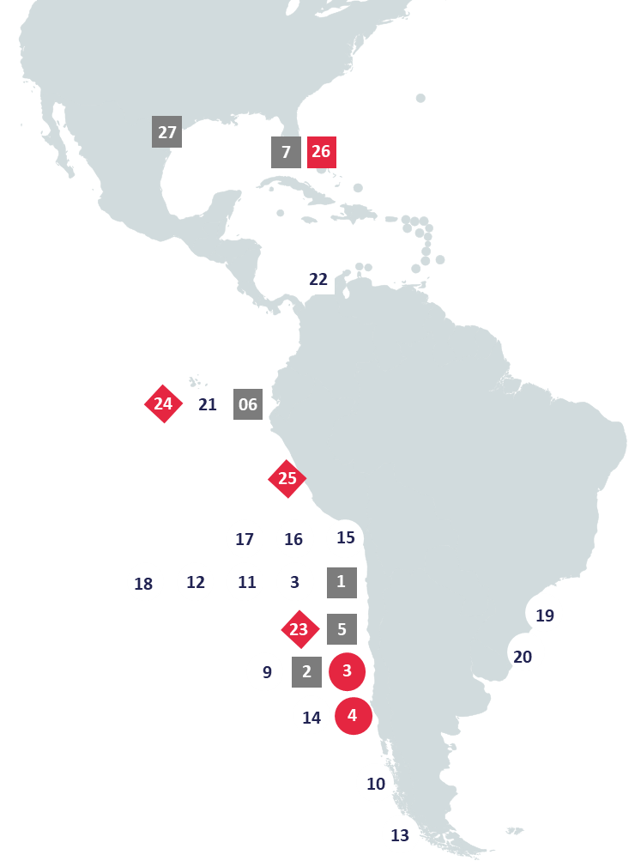
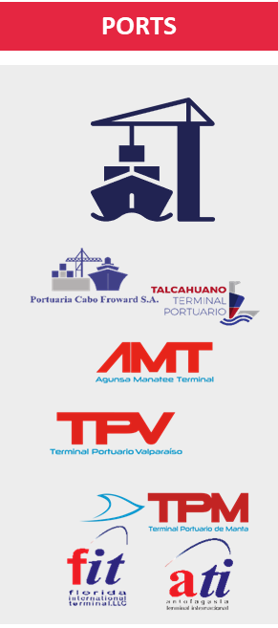
DISCLAIMER
ONE PAGER
GENERAL OVERVIEW
STRENGHTS
CORE BUSINESSES
FINANCIAL OVERVIEW
27
Revenue – EBITDA Margin (USD MM)
Multipurpose
Bulk
Intermodal
Owner
Concession
Port Services
PORT OPERATION [CONCESSION]
PORT SERVICES
1. Antofagasta Terminal Internacional (ATI)
2. Terminal de Talcahuano Portuario (TTP)
5. Terminal Portuario de Valparaíso (TPV)
6. Terminal Portuario de Manta (TPM)
7. Florida International Terminal (FIT)
26. AGUNSA Manatee Terminal (AMT)
27. AGUNSA Tampa Terminal (ATT)
8. Puerto Barquito (Chañaral-CHI)
9. Muelle CAP (Talcahuano-CHI)
10. Puerto Corbeta Papudo (Isla Guarello – CHI)
11. Terminal Multioperado Antofagasta (CHI)
12. Puerto Las Losas (Huasco-CHI)
13. Puerto Mardones (Pta.Arenas - CHI)
14. Empormontt (Pto.Montt – CHI)
15. Terminal Portuario Patache (Iquique-CHI)
16. SPL Terminal Patillos (Iquique-CHI)
17. Terminal Marítimo Collahuasi (Iquique-CHI)
18. Terminal Patache (Iquique-CHI)
19. Puerto de Montevideo (URU)
20. Puerto Ingeniero Buitrago (San Nicolás-ARG)
21. Terminal Portuario Bananapuerto (Guayaquil-ECU)
22. Sociedad Portuaria Puerto Bahía (Cartagena – COL)
PORT OPERATION [OWNER]
3. Terminal de Coronel (CHI)
4. Terminal de Calbuco (CHI)
INTERMODAL [OWNER]
23. Terminal Extraportuario San Antonio (CHI)
24. Terminal Extraportuario de Manta (ECU)
25. Terminal Extraportuario de Callao (PER)
COMPANY OVERVIEW | DECEMBER 2024

Slide 12
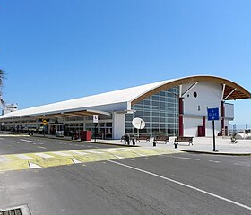

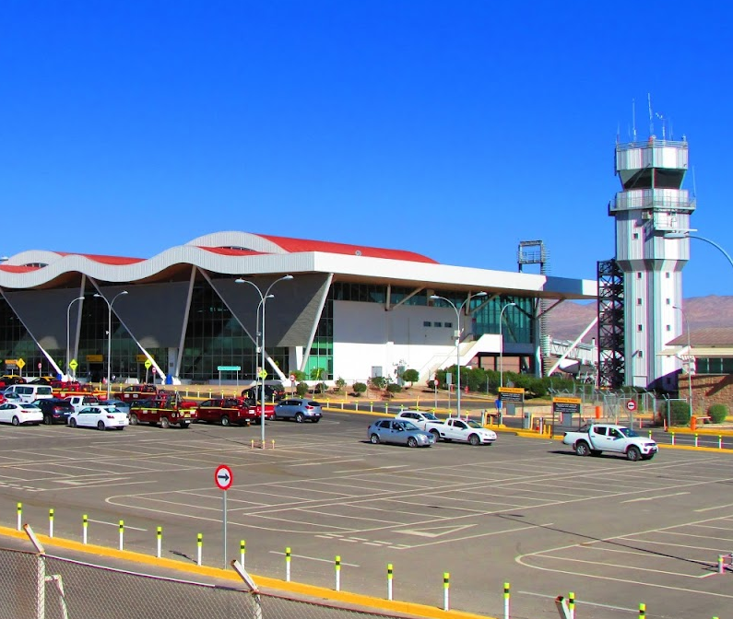
DISCLAIMER
ONE PAGER
GENERAL OVERVIEW
STRENGHTS
CORE BUSINESSES
FINANCIAL OVERVIEW
AIRPORTS
Arica
Revenue – EBITDA Margin (USD MM)
Puerto Montt
GEN through AGUNSA works with Airport Concessions from the following companies:
  Arica and Puerto Montt Concessions are in partnership with SACYR with fixed term.
  Consorcio aeroportuario de Calama S.A. Concessionaire, which manages the airport El Loa city of Calama, Chile.
  AGUNSA provides different types of services such as parking, passenger services, shopping center (Duty Free). Additionally, it offers logistic and agency services to the aircrafts.
COMPANY OVERVIEW | DECEMBER 2024
Calama

Slide 13













DISCLAIMER
ONE PAGER
GENERAL OVERVIEW
STRENGHTS
CORE BUSINESSES
FINANCIAL OVERVIEW
AGENCY SERVICES
AGUNSA with over 50 years of experience representing major shipping companies, has achieved a leading position in its local market, covering operational requirements alongside the legal and financial aspects of its clients both domestic and internationally.
AGUNSA safeguards the interests of its customers, according to the requirements of their ships, in addition to the needs of the crew. Its international presence, through its network of partners, enables us to deliver specialized attention in a vessel call, liner or tramp in various national and international ports.
Main services: General Agency, Port Agency, Protecting Agency, Bunkering and others
Revenues – EBITDA Margin (USDmm)
Agency & maritime representation
Spain: Cosiarma
Colombia: Marfret, ZIM, PTE + others
Mexico: Wan Hai, Chunan, Seven Seals,
Peru: Marfret, Hyundai Glovis, K-Line, Seven Seals + others
Chile: Yang Ming, ZIM, Hyunday Glovis, Go Star, Seven Seals, Kline, + others
Central America: Maersk, PIL, Yang Ming, Dole, Chunan atendemos en puerto, Koga Shipping, Wanway Chile, HLC
Ecuador: Maersk, Wan Hai, Marfret, Baltic, ZIM, X-Press Feeder
Pendiente
Air companies representation & Ground Handling
GSA (PAX)
Colombia: Spirit
Chile: Emirates Group, Air Canada, Delta, American, United, Korean, Kalitta, Qatar, Jetsmart, Turkish
Peru: Emirates Group, Air Canada, Spirit
Ecuador: Emirates Group, Air Canada, Hahn Air, Spirit
GSA (Cargo)
Argentina: Emirates Group
Chile: Emirates Group, Kalitta, Korean, DSV, K&N
Ecuador: Air Canada
Pendiente
Main Customers
Back Office
Spain: Cosiarma
Mexico: Wan Hai
Central America: PIL, Yang Ming, DOLE, mearsk
Chile: Yang Ming, Hyundai Glovis, K Line, ZIM, Seven Seals, one, go star
Peru: Hyundai Glovis, K-Line, Marfret, King OCean
Ecuador: Marfret, Yang Ming, ZIM, Del Monte, Wan hai
Pendiente
COMPANY OVERVIEW | DECEMBER 2024

Slide 14
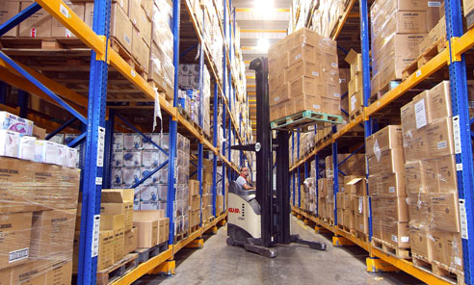
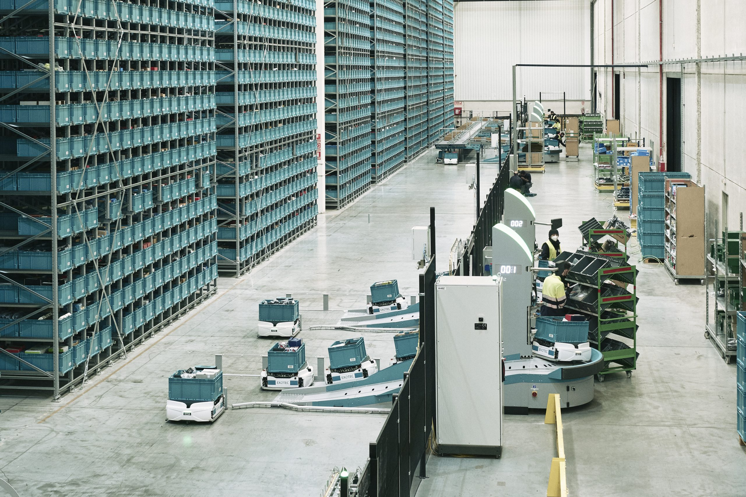
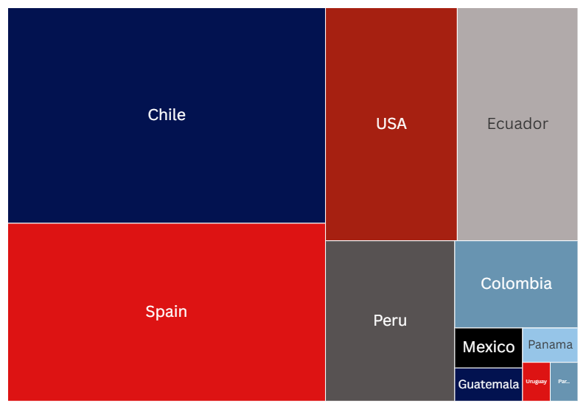
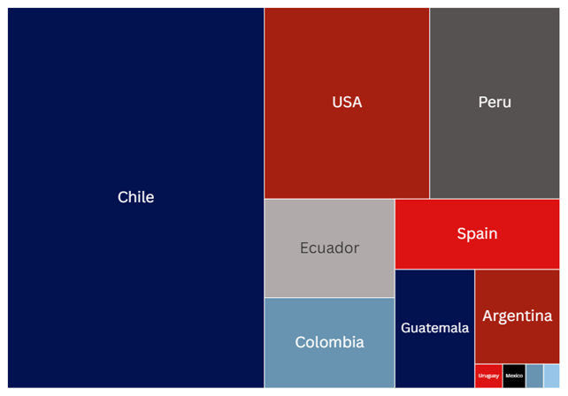
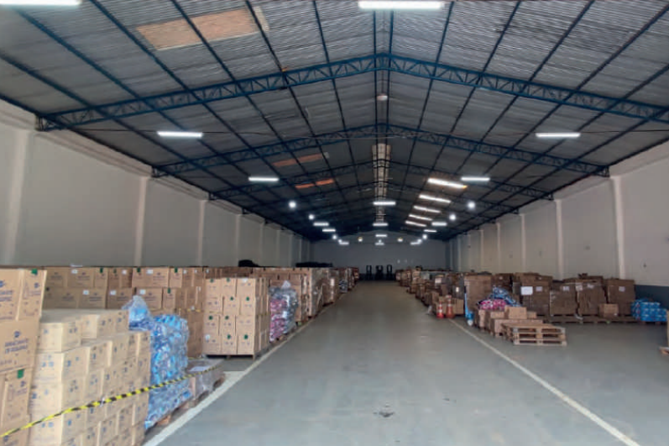
DISCLAIMER
ONE PAGER
GENERAL OVERVIEW
STRENGHTS
CORE BUSINESSES
FINANCIAL OVERVIEW
LOGISTICS
AGUNSA is one of the main players in the logistics industry, with a strong domestic and international presence.
Services include:
International Logistics
Warehousing and Distribution
Container Terminal
Ground Transportation
Container Sales & Leases
Retail Industry Logistics
Mining Industry Logistic
Other Industries Logistic Services
In 2023 AGUNSA acquired a 75% in ESBO Logistics in Spain.
Revenue – EBITDA Margin (USD MM)
Warehouse Capacity: 432 M m²
Total Surface: 1.962 M m²
131.632 m²
295.764 m²
232.863 m²
58.985 m²
54.000 m²
108.448 m²
120.217 m²
20.600 m²
75.000 m²
108.448 m²
39.758 m²
912.685 m²
110.100 m²
88.503 m²
COMPANY OVERVIEW | DECEMBER 2024
14

Slide 15
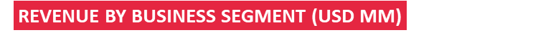
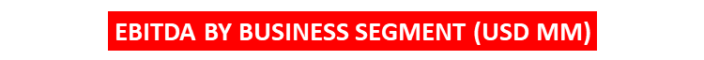
DISCLAIMER
ONE PAGER
GENERAL OVERVIEW
STRENGHTS
CORE BUSINESSES
FINANCIAL OVERVIEW
REVENUES & EBITDA EVOLUTION
COMPANY OVERVIEW | DECEMBER 2024
15

Slide 16
DISCLAIMER
ONE PAGER
GENERAL OVERVIEW
STRENGHTS
CORE BUSINESSES
FINANCIAL OVERVIEW
Debt Composition
Current Maturity Profile (USD MM)
December 2023
December 2024
USD
576 MM
USD
709 MM
COMPANY OVERVIEW | DECEMBER 2024
16

Slide 17
DISCLAIMER
ONE PAGER
GENERAL OVERVIEW
STRENGHTS
CORE BUSINESSES
FINANCIAL OVERVIEW
GEN FINANCIAL HIGHLIGHTS (USD MM)
Revenues || EBITDA Margin
DFN / EBITDA
Financial Debt⁽¹⁾ || Leverage⁽²⁾
Financial Expenses / EBITDA
Source: Company information
(1) Financial Debt = Other Non-current Financial Liabilities + Other Current Financial Liabilities
(2) Leverage = Total Liabilities / Equity
COMPANY OVERVIEW | DECEMBER 2024

Slide 18
COMPANY OVERVIEW
DECEMBER 2024

